Slide 1
Building Robust Data Ingestion Pipelines: A Comprehensive Guide

Slide 2
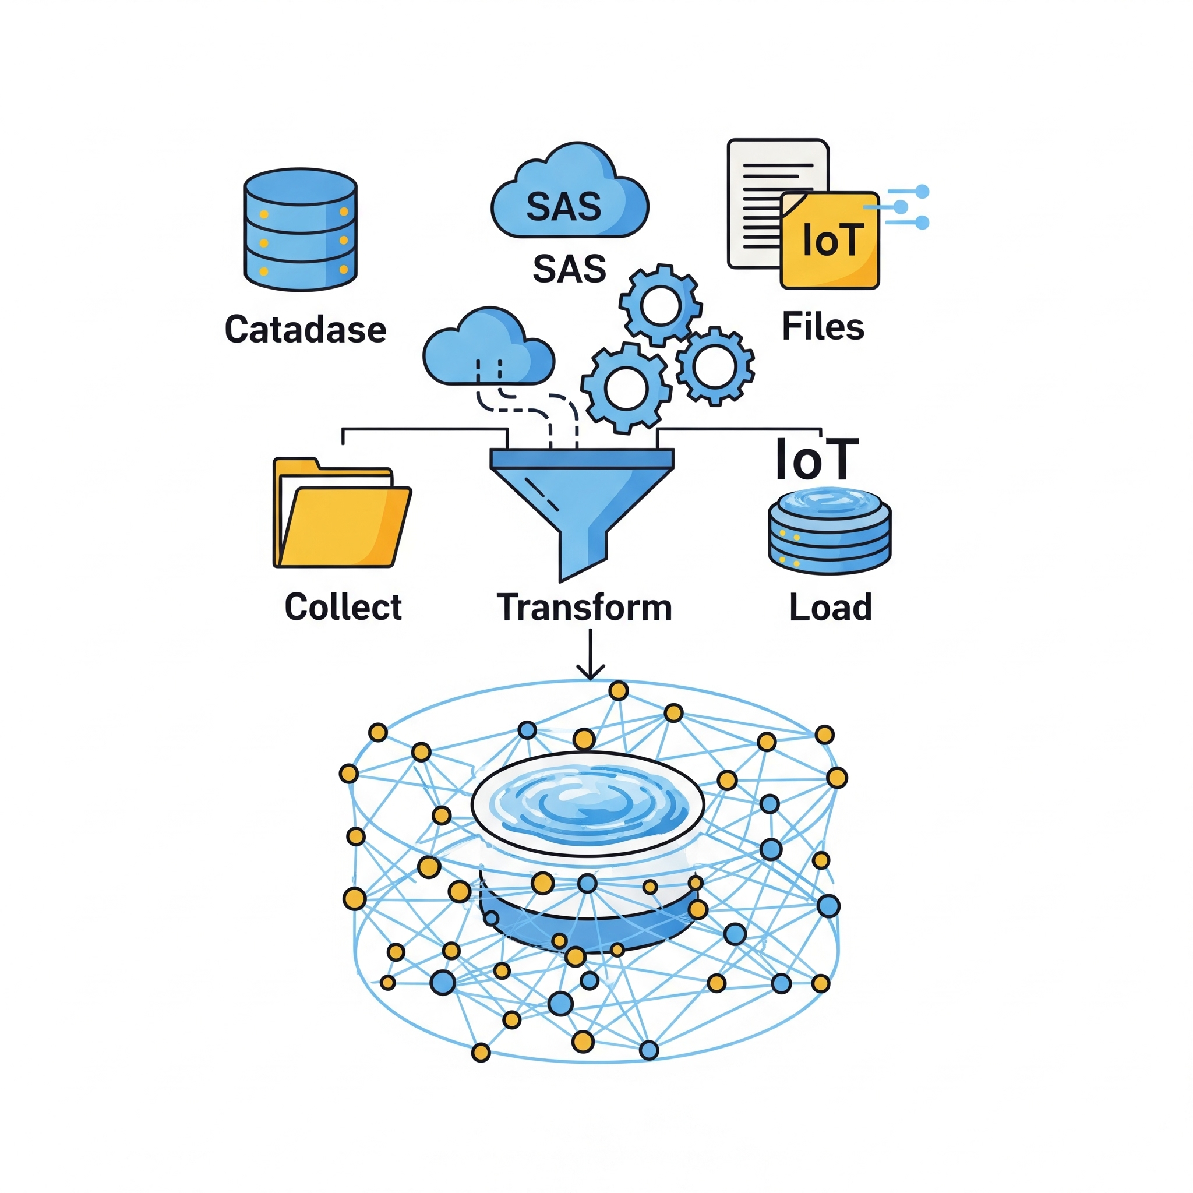
Data Ingestion Pipeline

Slide 3
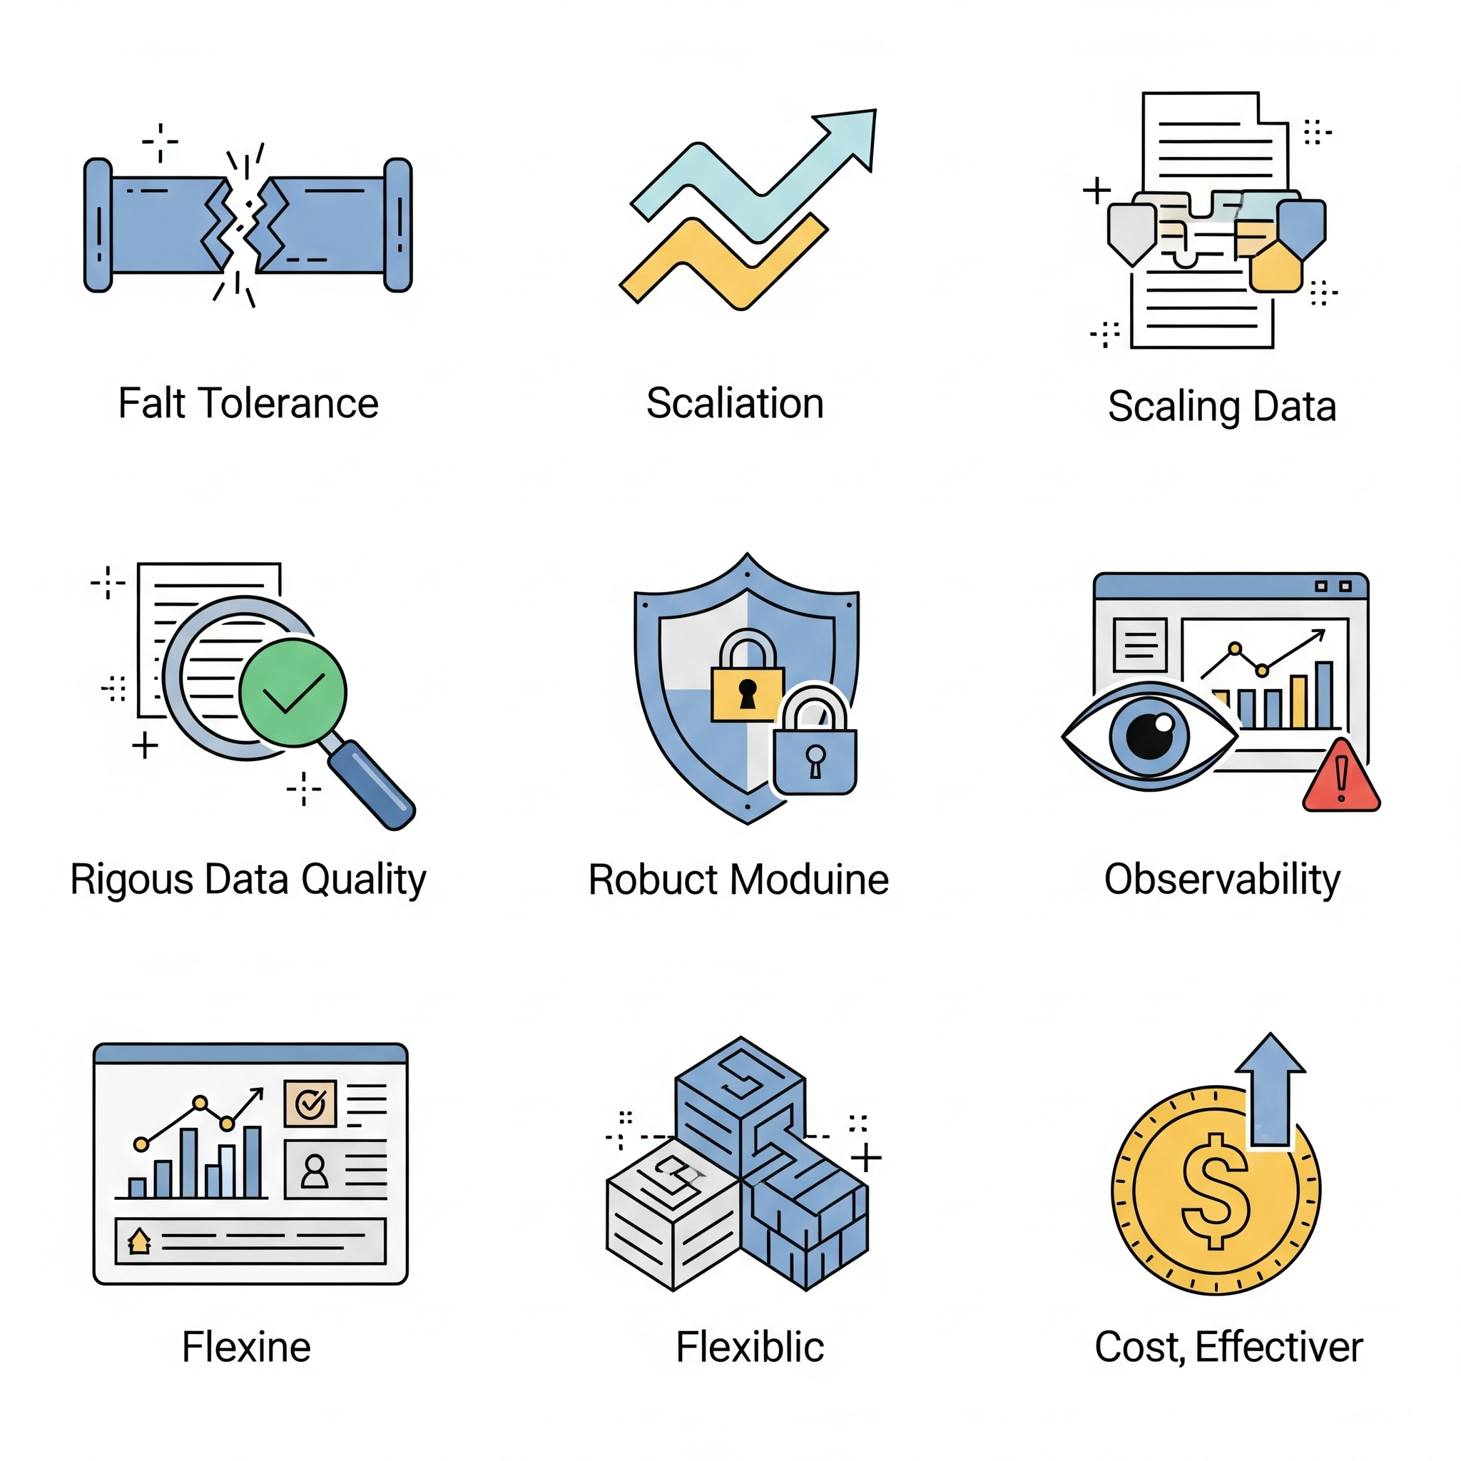
Key Characteristics of a Robust Pipeline

Slide 4
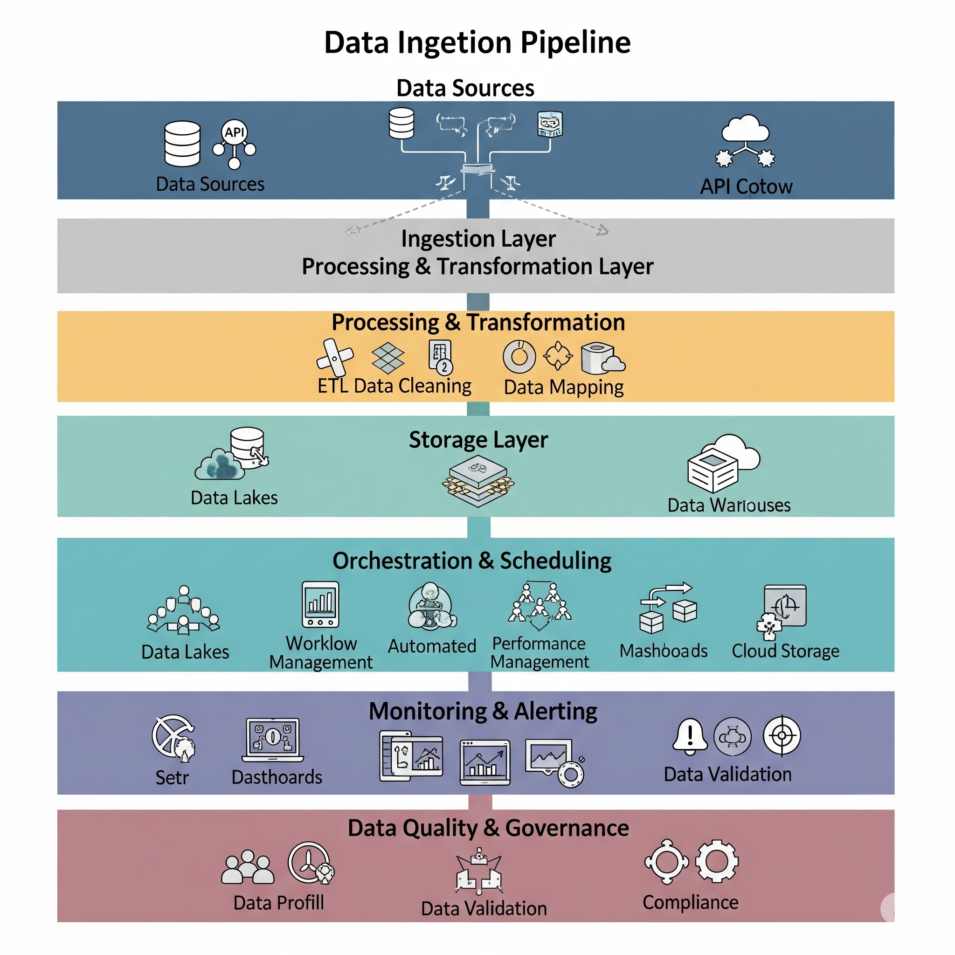
Core Components of a Data Ingestion Pipeline

Slide 5
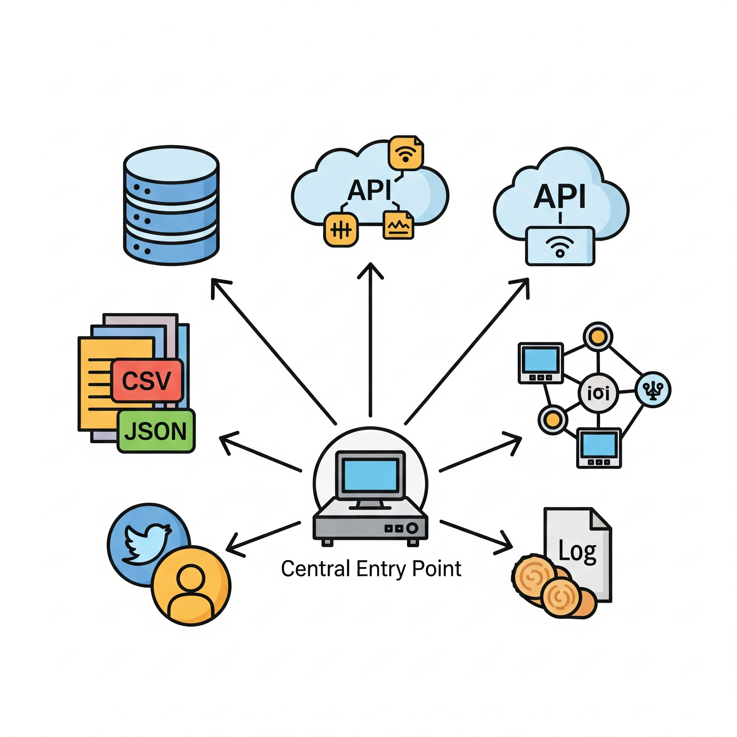
Data Sources

Slide 6
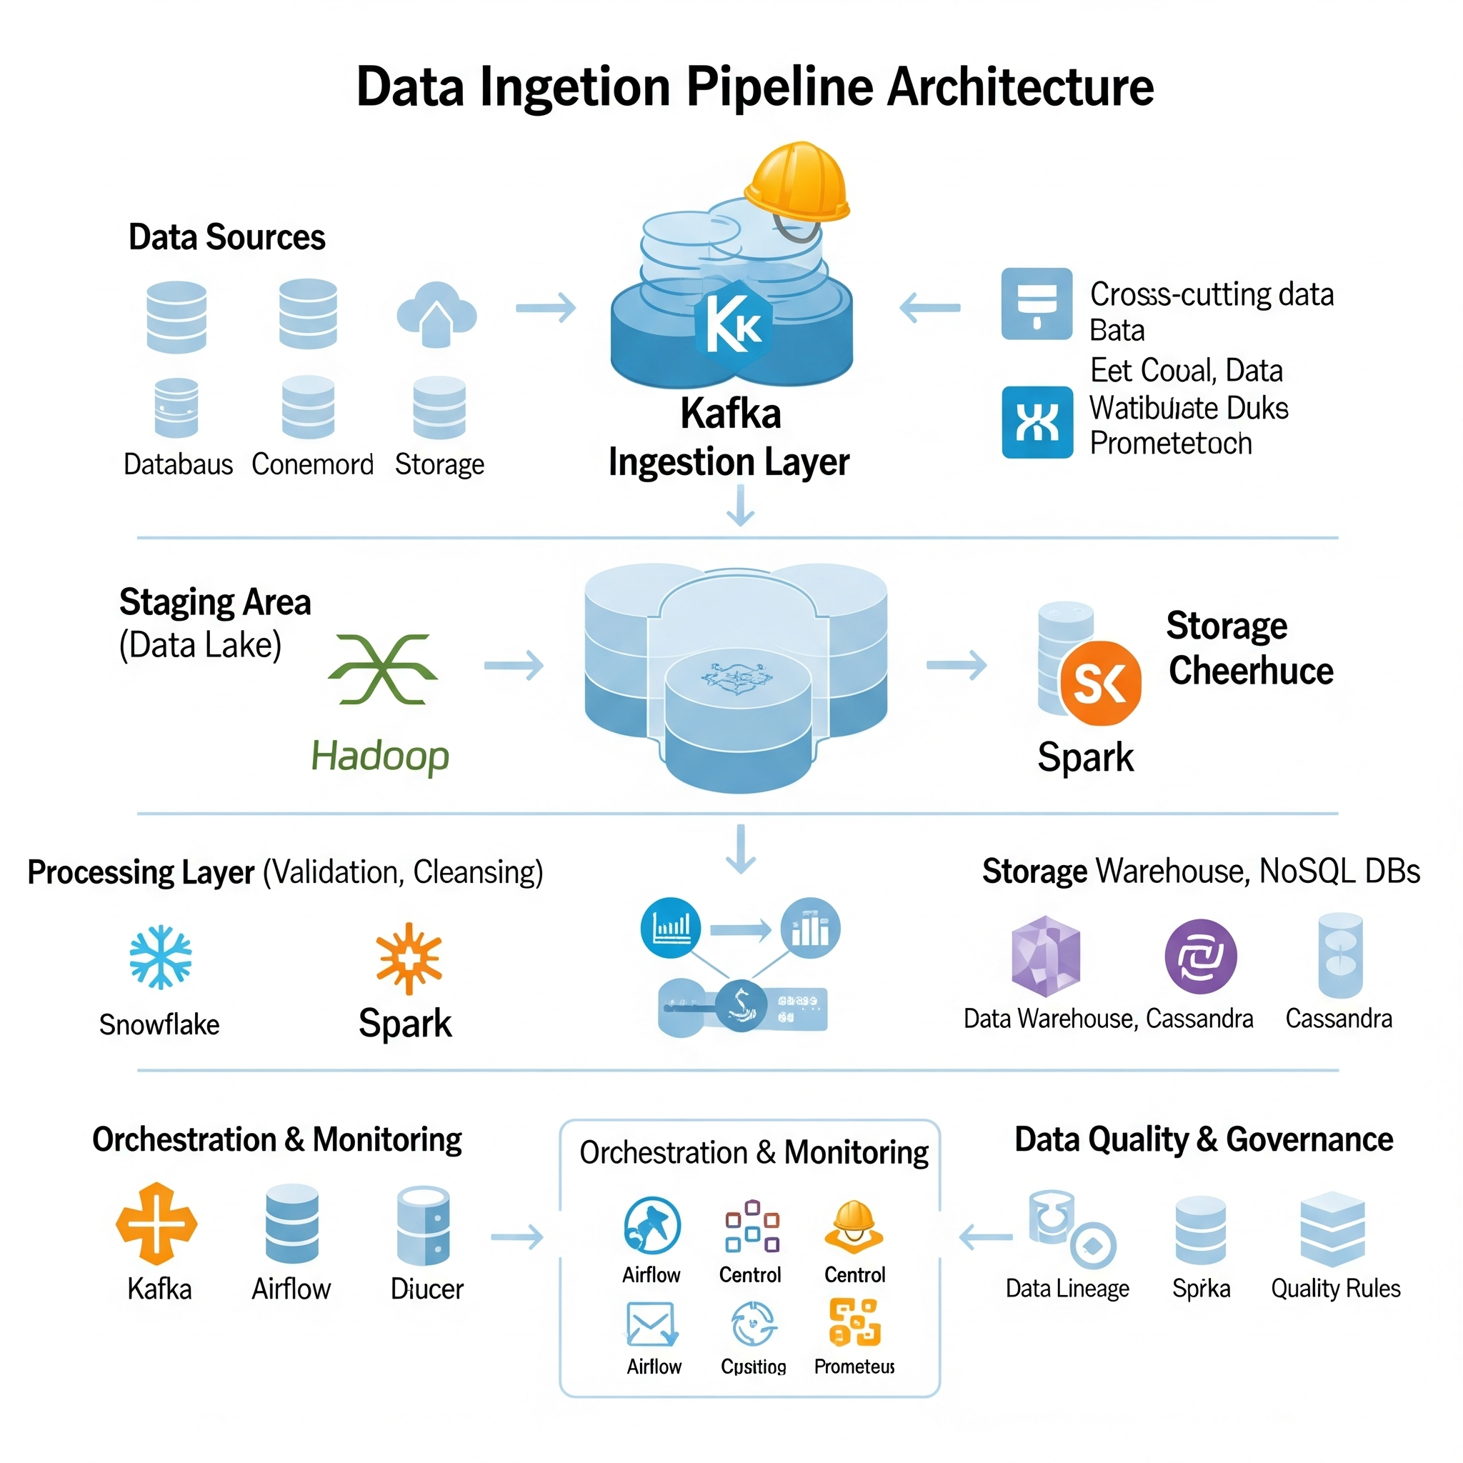
Architecture

